Slide 1
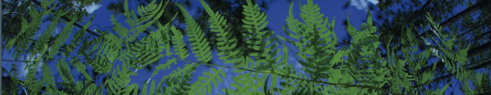

Data Download
University of Florida

Slide 2
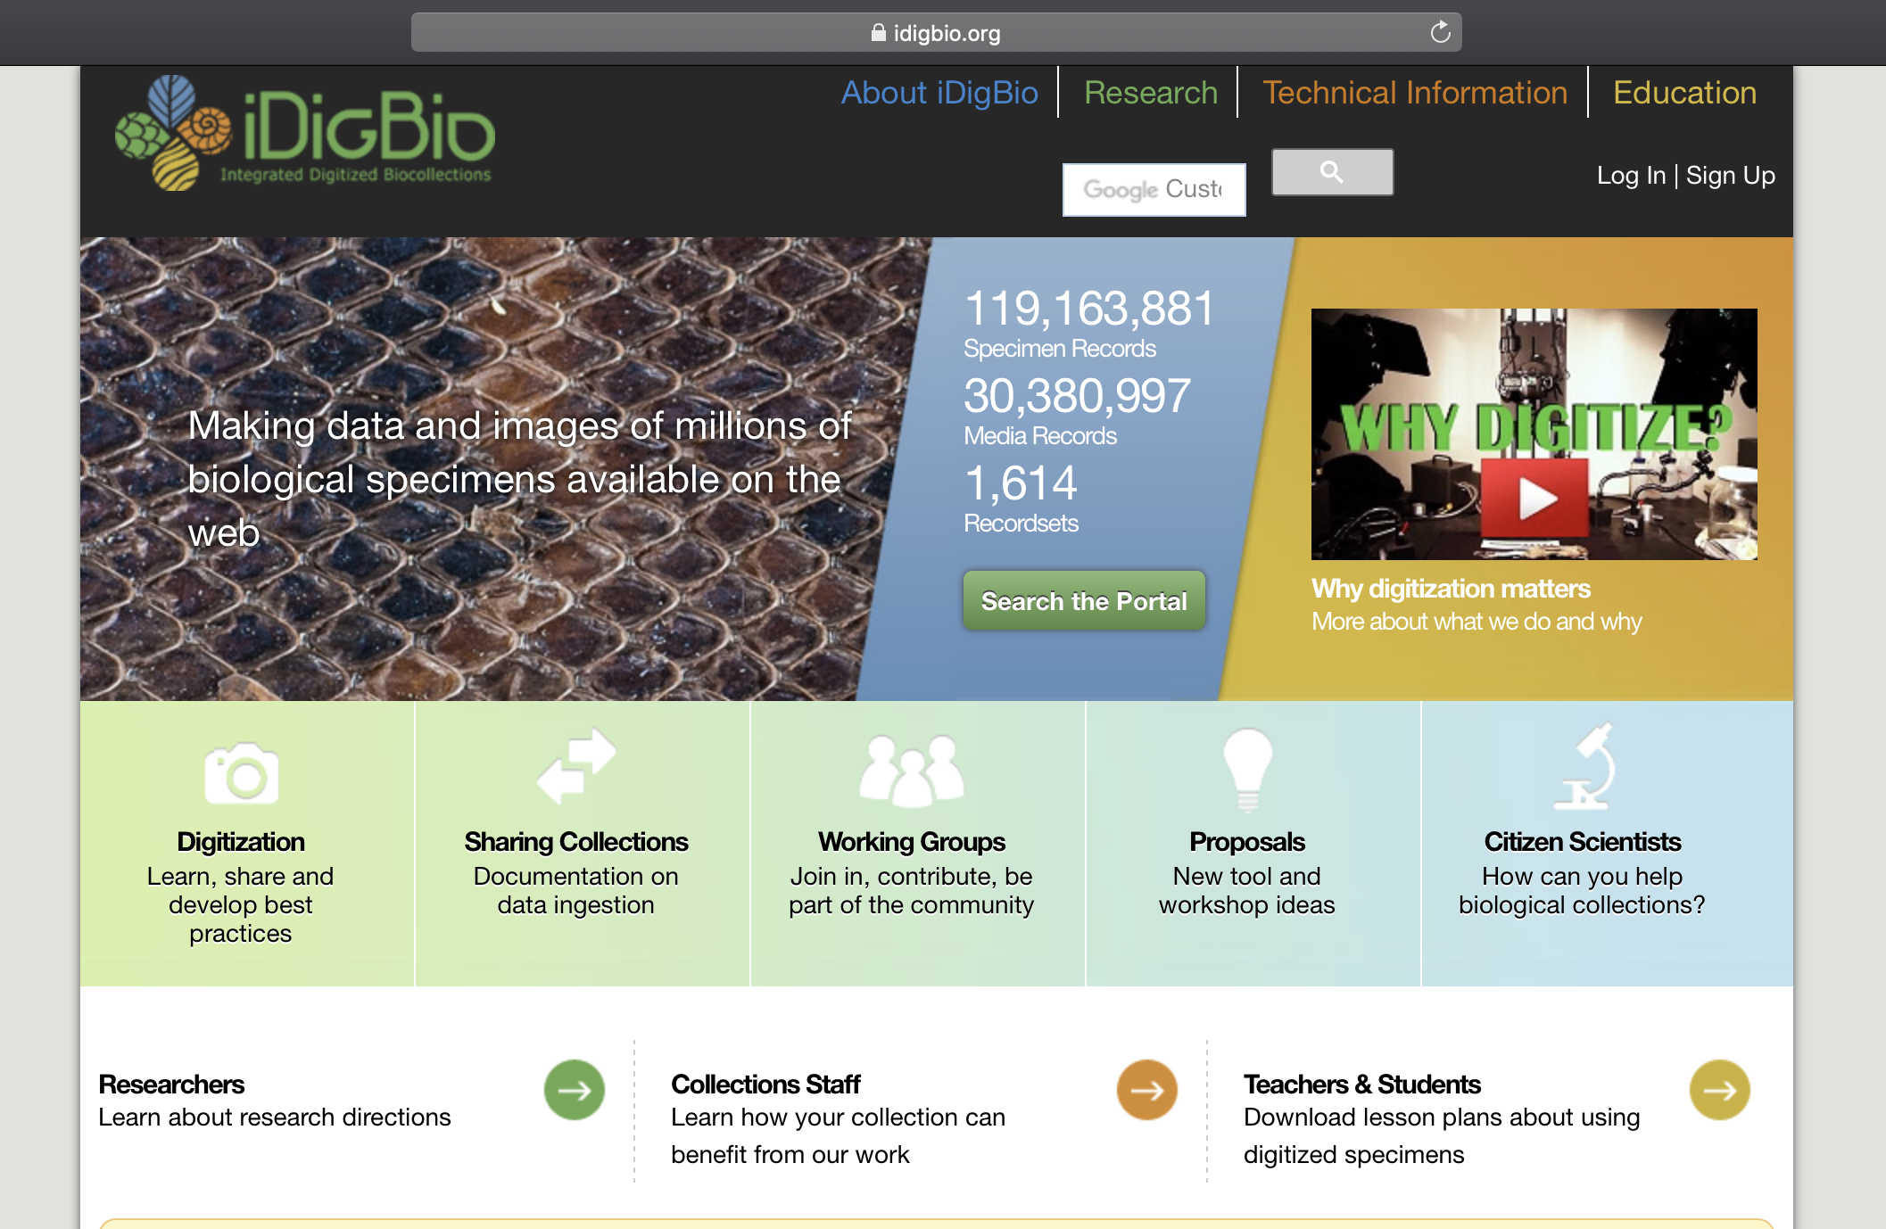

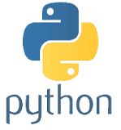
API = Application Programming Interface
Allows users to interact with a system
Webportal
API
Programing language
Database
Interface

Slide 3
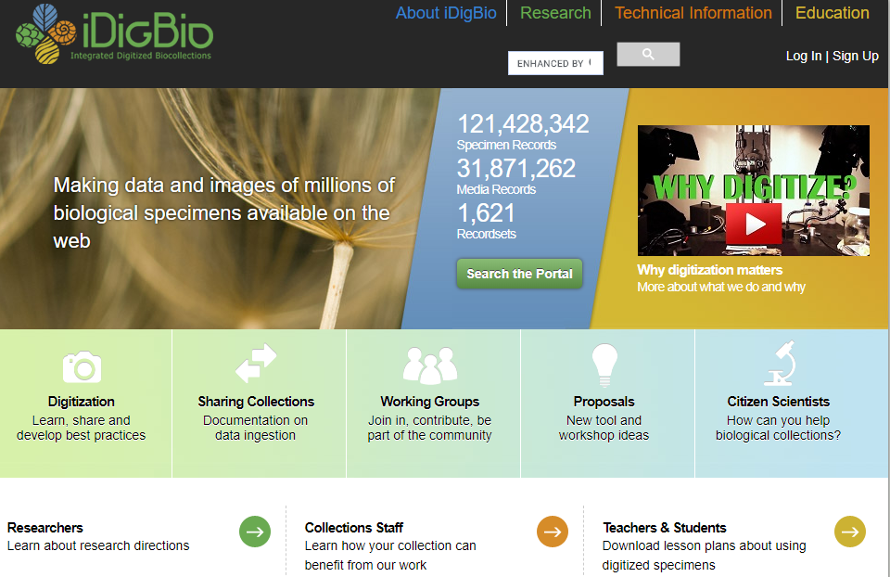

Slide 4

iDigBio API
Multiple ways to access the API:
API Name | Info
Search API | ridigbio R package <100,000 records
Download API | >100,000 records
Record API | Single record
Media API | Single record
biodiversity-specimen-data/specimen-data-use-case

Slide 5
R based
“Demo/Rbased/CrashCourse/CrashCourse.Rproj”
Navigate to Download_Occurence_Data.R

Slide 6
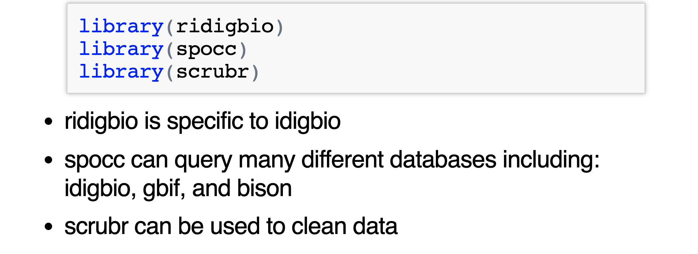





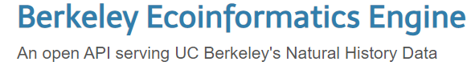
Load Packages
Notes:
spocc- Global Biodiversity Information Facility ('GBIF'), 'USGSs' Biodiversity Information Serving Our Nation ('BISON'), 'iNaturalist', Berkeley 'Ecoinformatics' Engine, 'eBird', Integrated Digitized 'Biocollections' ('iDigBio'), 'VertNet', Ocean 'Biogeographic' Information System ('OBIS'), and Atlas of Living Australia ('ALA'). Includes functionality for retrieving species occurrence data, and combining those data.
Ridigbio-Interface to the iDigBio Data API

Slide 7
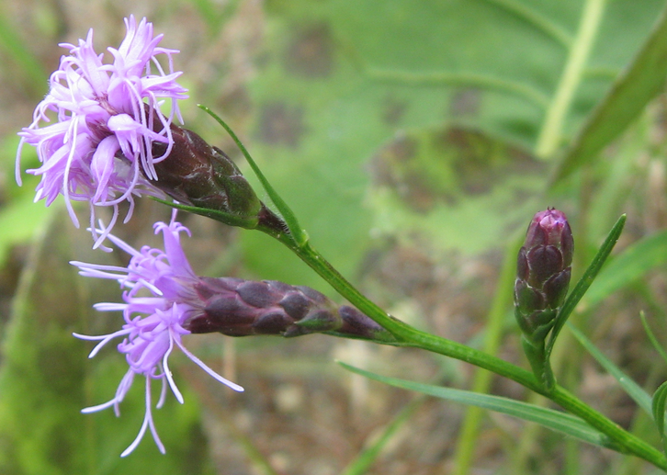
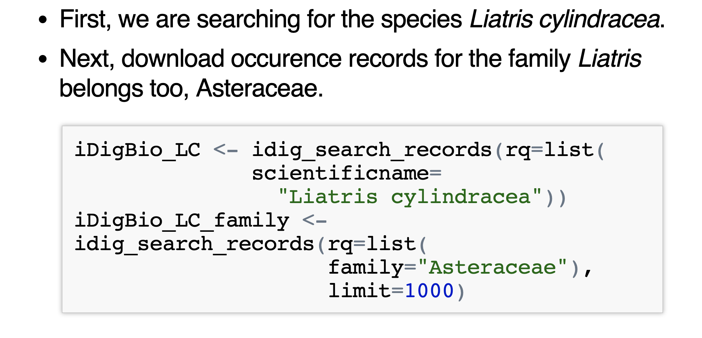
Downloading data using ridigbio

Slide 8
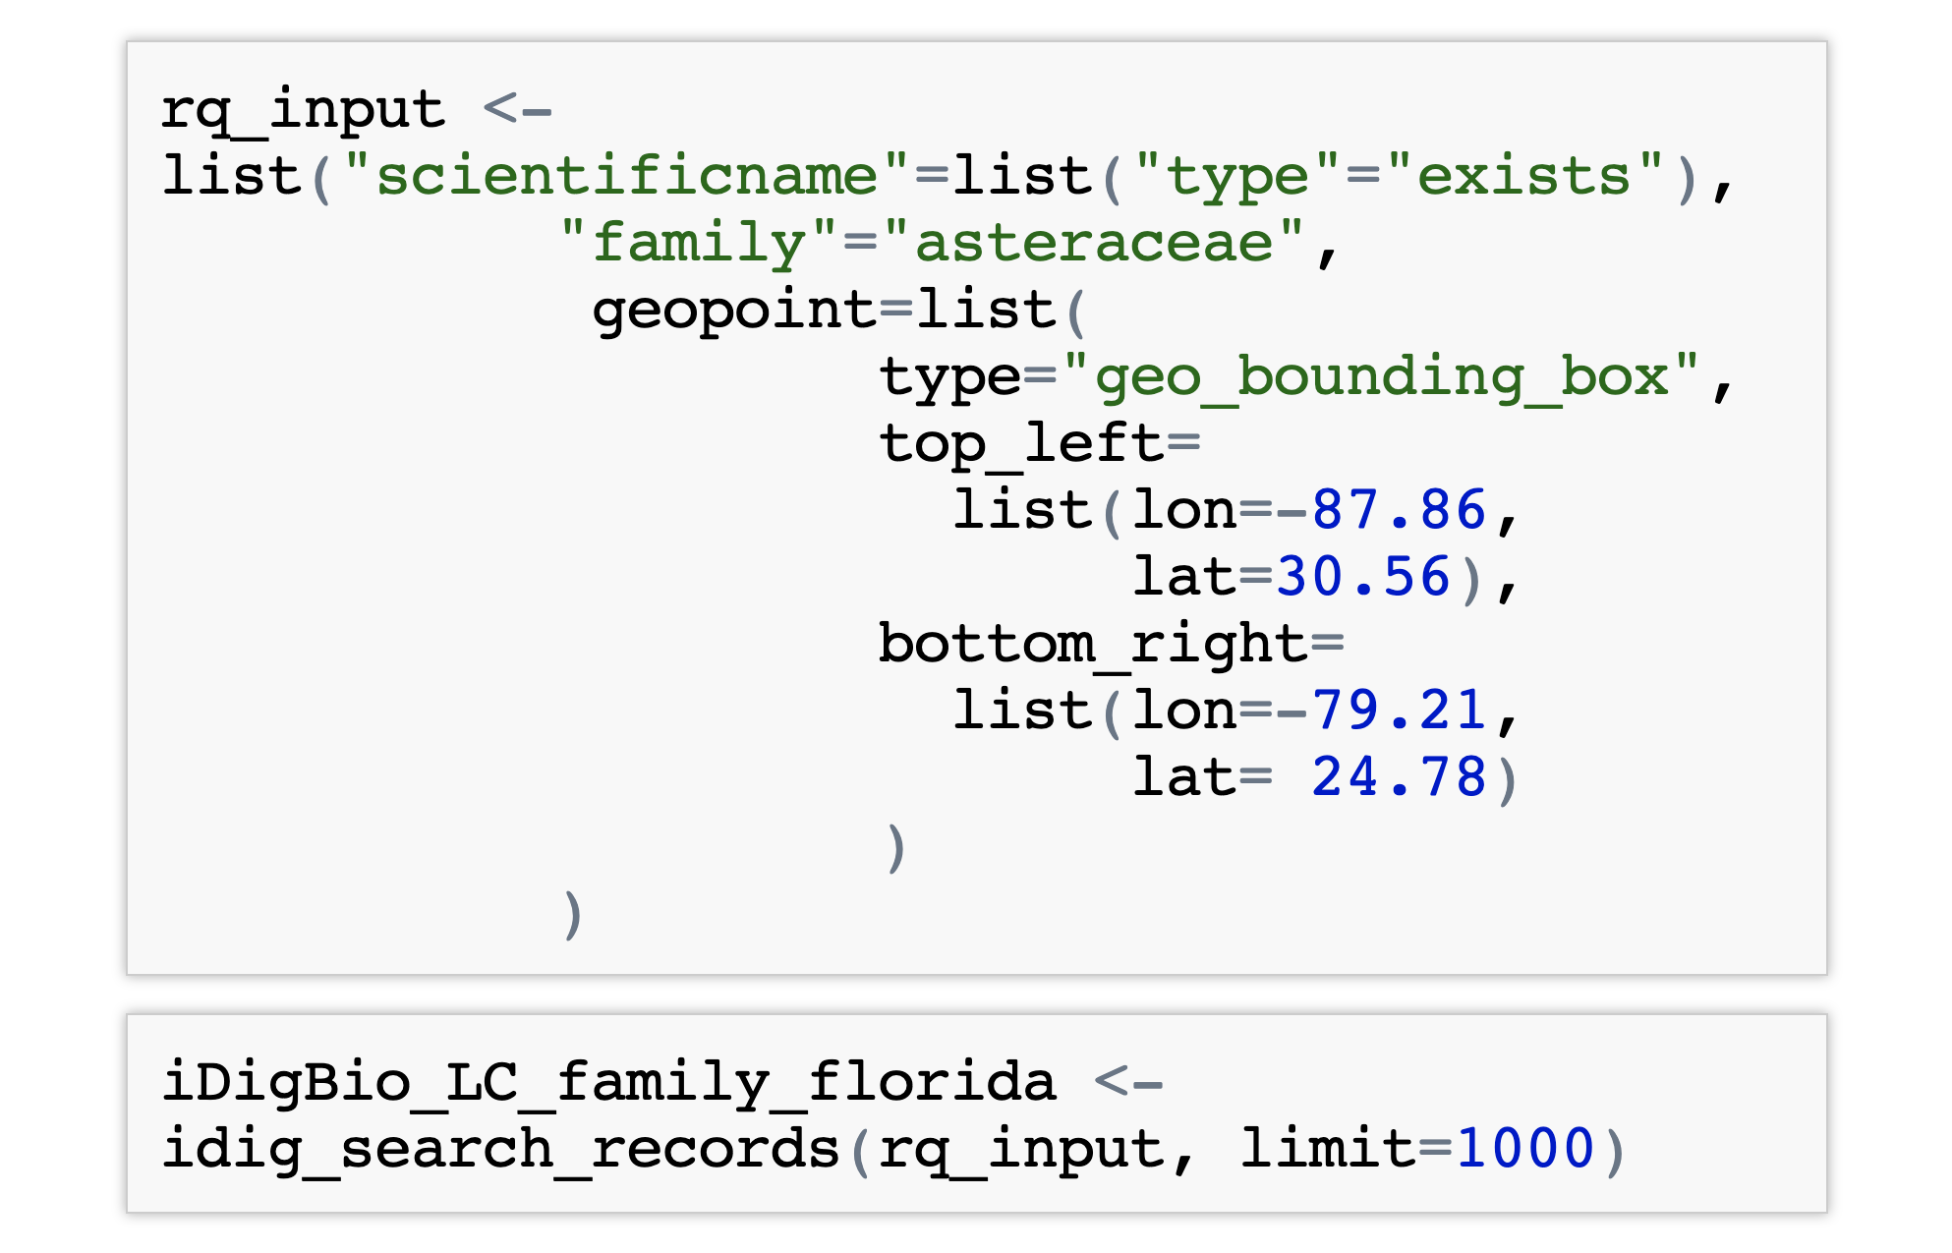
Records only in Florida

Slide 9
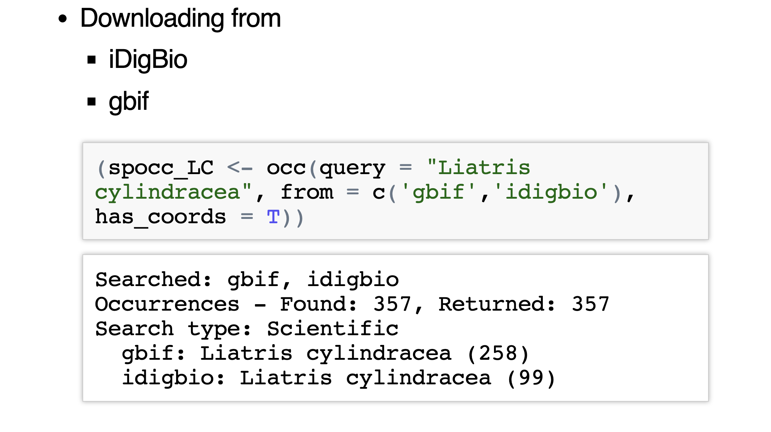
Data download using spocc

Slide 10
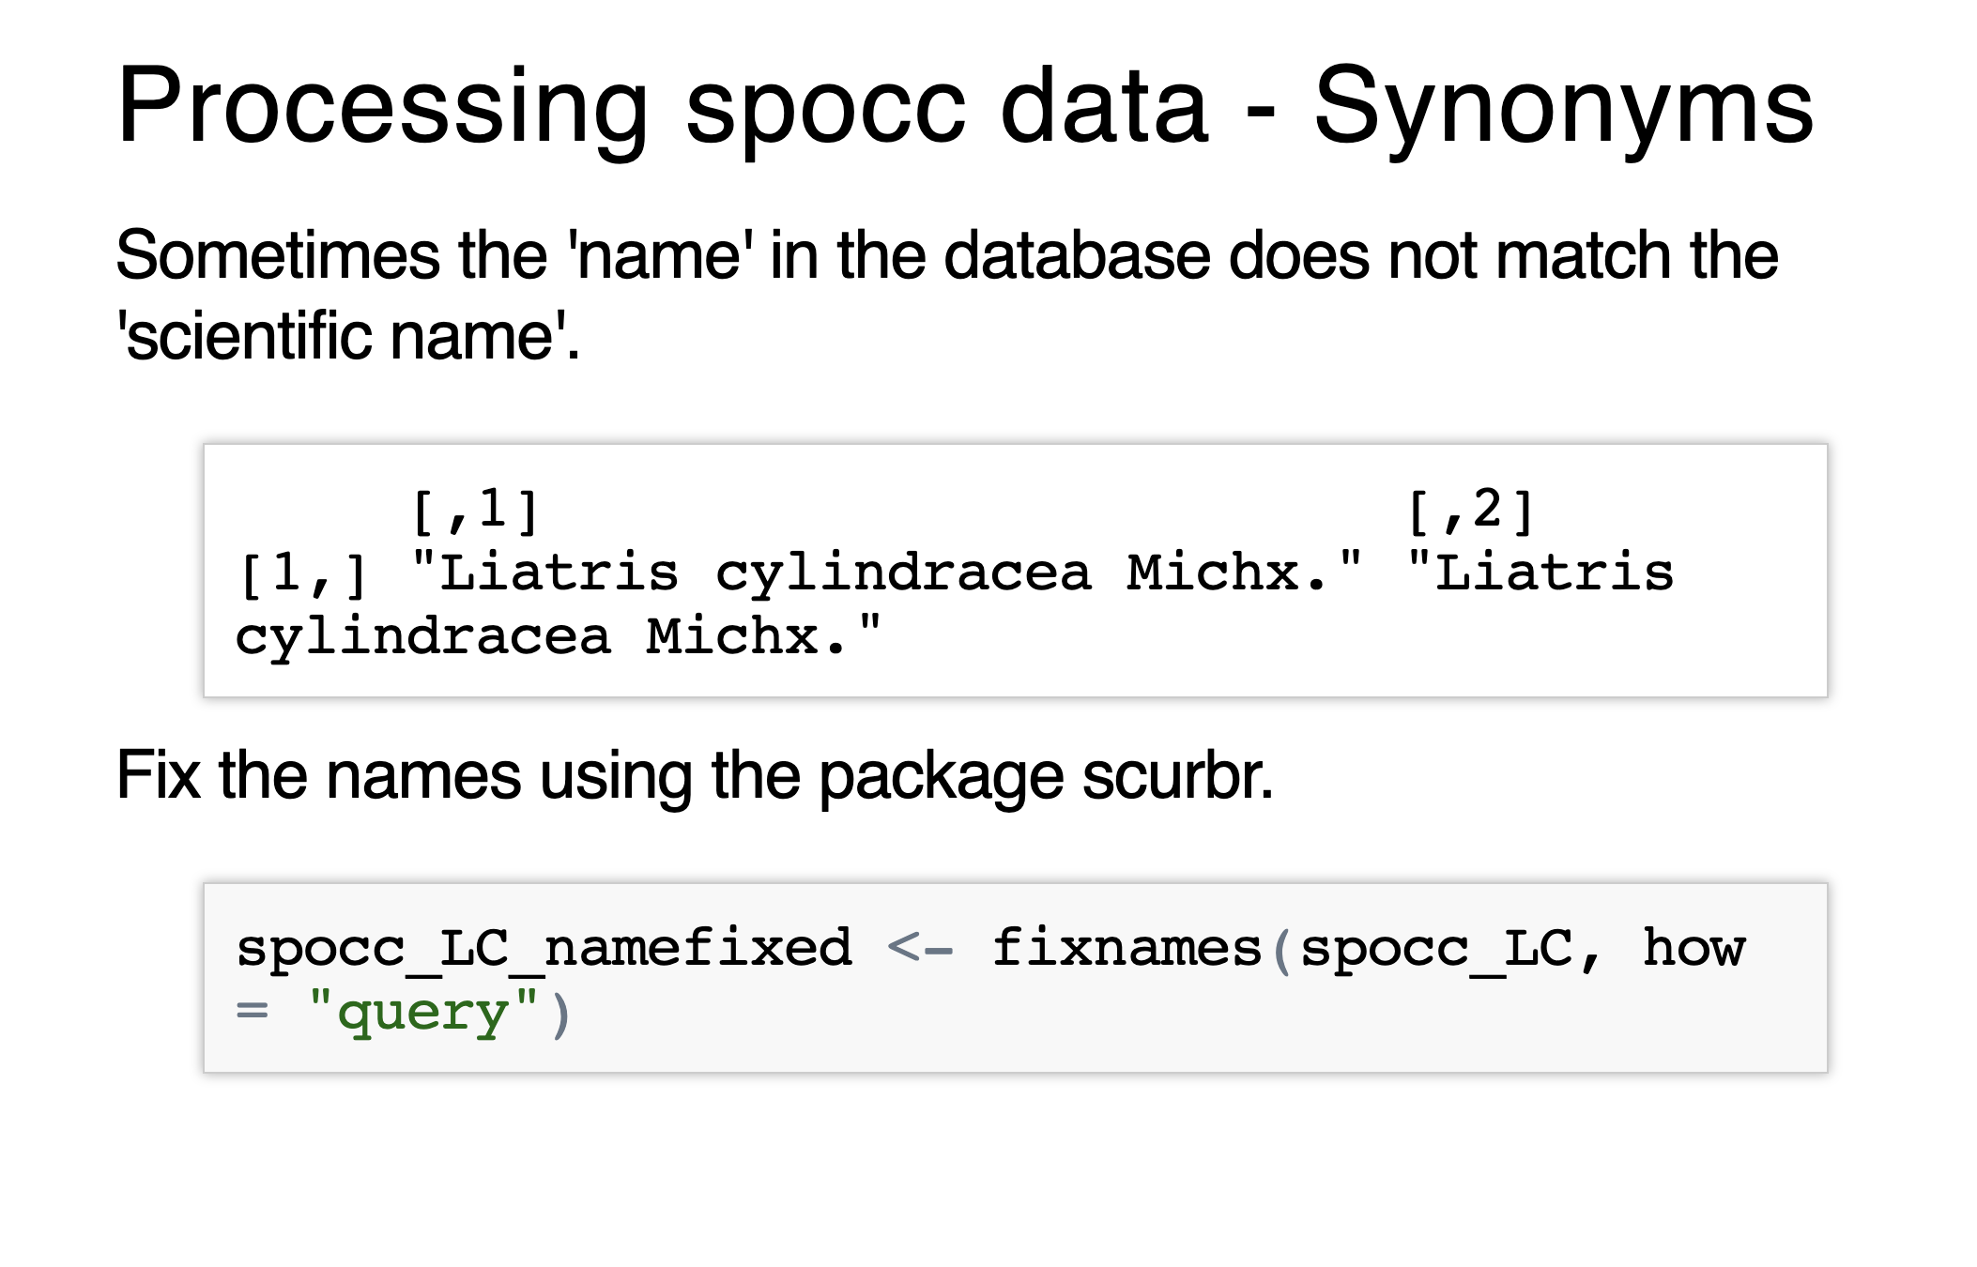
Processing spocc - Synonyms

Slide 11
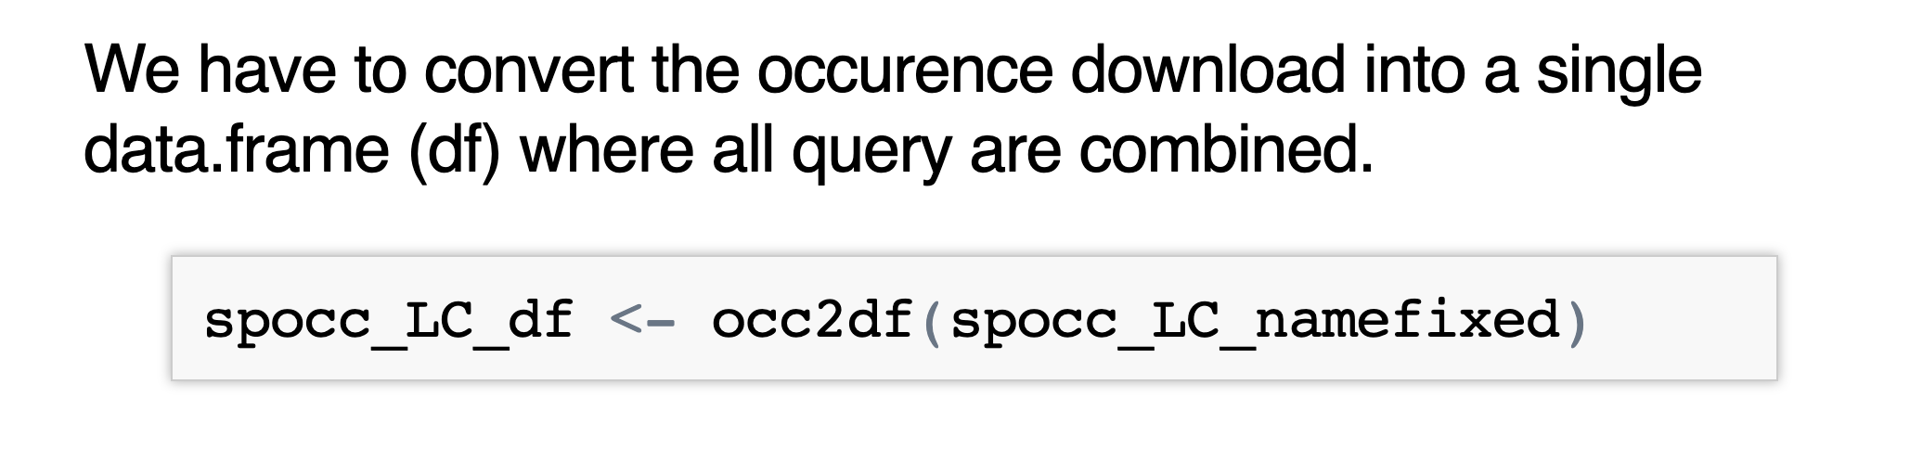
Processing spocc – Data Format

Slide 12
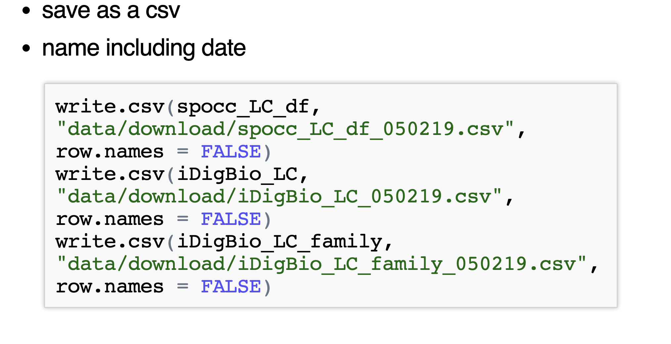
Saving downloaded data

Slide 13



Other considerations:
Download from multiple repositories
Identify flagged data
Identify data for georeferencing

Slide 14
Other considerations:
Download from multiple repositories
Identify flagged data
Identify data for georeferencing
mgaynor1/CURE-FL-Plants

